Slide 1
Motel brokerage system
Team 5: Nguyen tuan nghia – HE141202
pham ich du – HE141231
nguyen dinh thanh Phuoc – HE141388
tran hai long – HE141390
nguyen dang hoang long – HE140400
Supervisor: Mr. pham ngoc ha

Slide 2
Product background

Slide 3
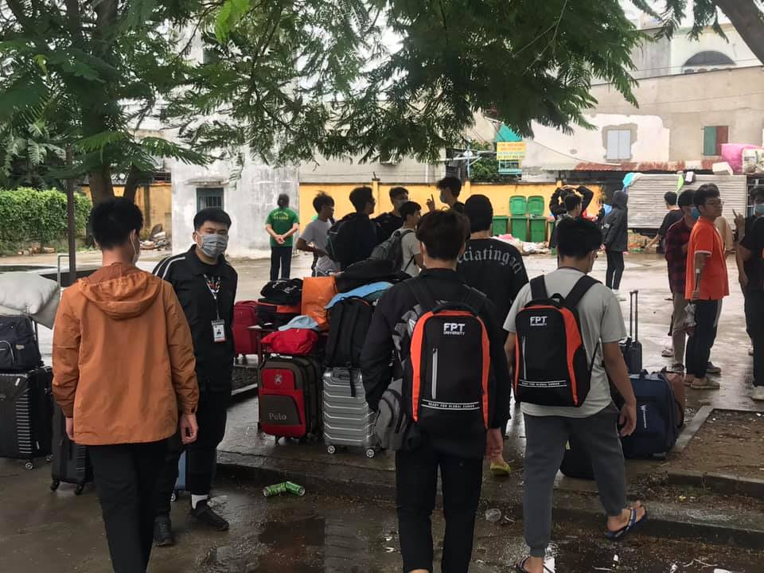
When new students come to FPT, if they don’t want to stay in dorms, they will choose staying in motel (outside of University area). It’s usually takes students (or student parents) from 4-8 weeks to find a motel that comfortable and convenient to stay, this happen not only for new students but also for student who already studying in FU. This wasting of time to finding place arise because lack of information and confirmation. Posts in groups on Facebook is not always provide enough information and status of rooms in motel, if students want to know details, they have to notice other student’s comments in that post to see that is motel as good as its describe. Hence to these problems, we come up with an idea creating a website/application that give students an easier way to find motel, also give them the ability to give feedback about motel. Besides, its also help motel owners a way to advertise there motel to students.

Slide 4
Existing system

Slide 5
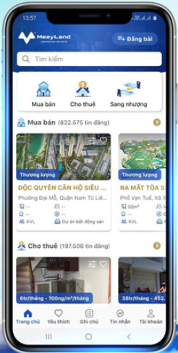
meeyland
a) Mobile application GUI
MeeyLand can also downloaded on CH Play , Appstore .The mobile app is used by customer who has already registered for their own account . If an user is a new user , he/she can even watch the information of the house that rent or even sell without create an account . From the app :
+ User can Update their information ( link to facebook account , etc…) they can also link to their bank account ( create account )
+ Users can create their own note for comparing houses they want to rent or remember the house that they noted, user can liked or love to saved the property that they like
+ Update location user ( if they allow ) through the app
+ Can watch information about the houses without login into the system

Slide 6
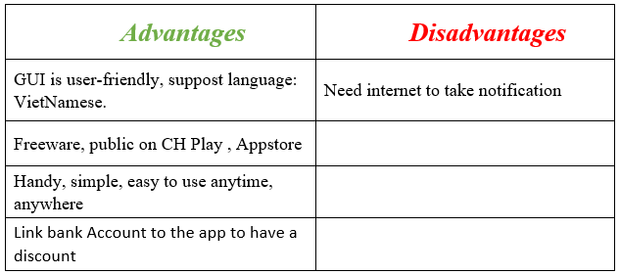

Slide 7
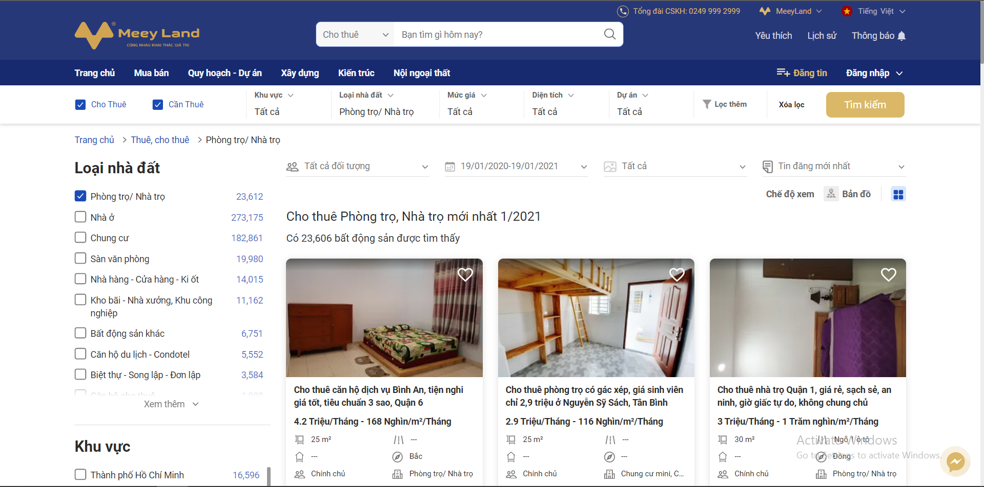
meeyland
b) Web application GUI

Slide 8
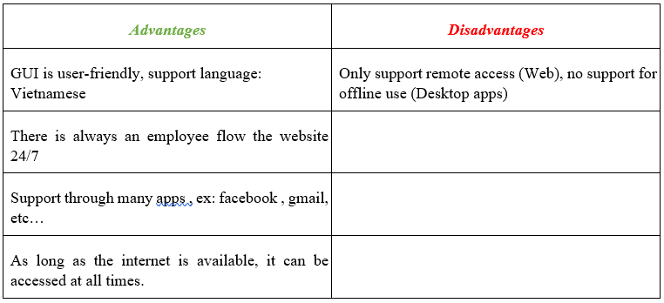

Slide 9
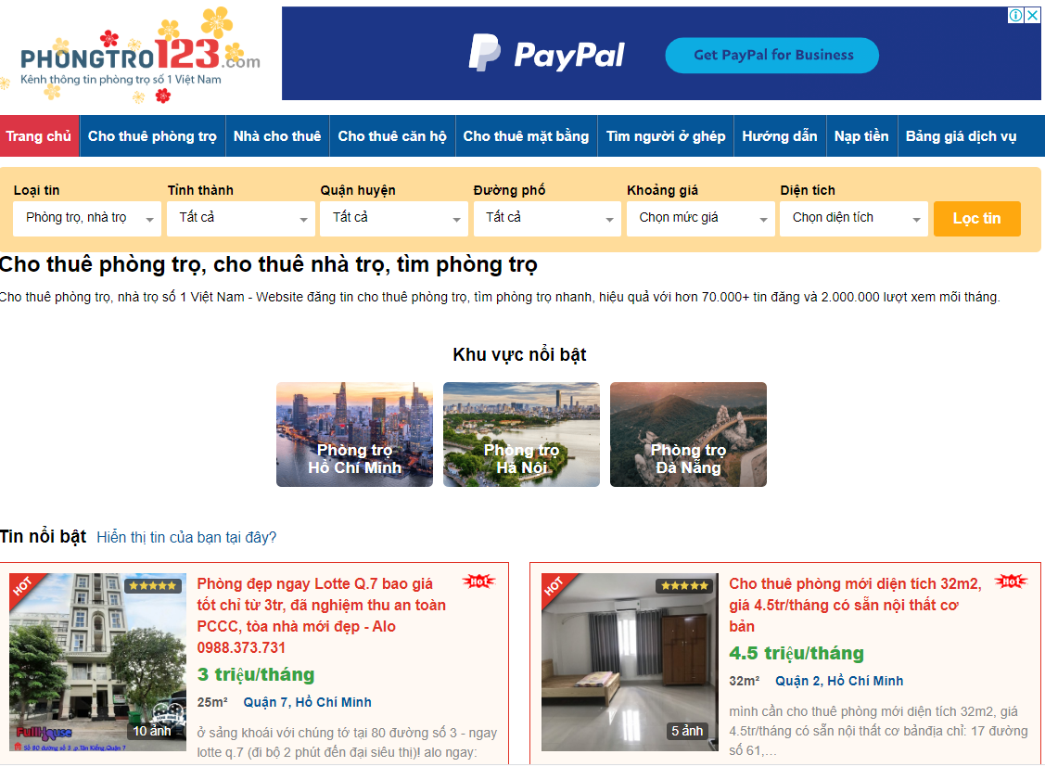
Phong tro 123
Website phongtro123.com focuses on only two groups of people, who have motels, rooms for rent and those who need to find motels. Therefore, the categories and features of the site provide the best support for users: such as creating, rent, updating and deleting motel, etc... This page stored on server. which brings many benefits of Security

Slide 10
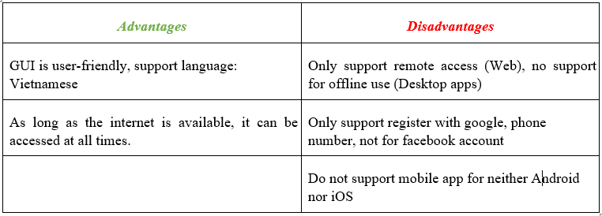

Slide 11
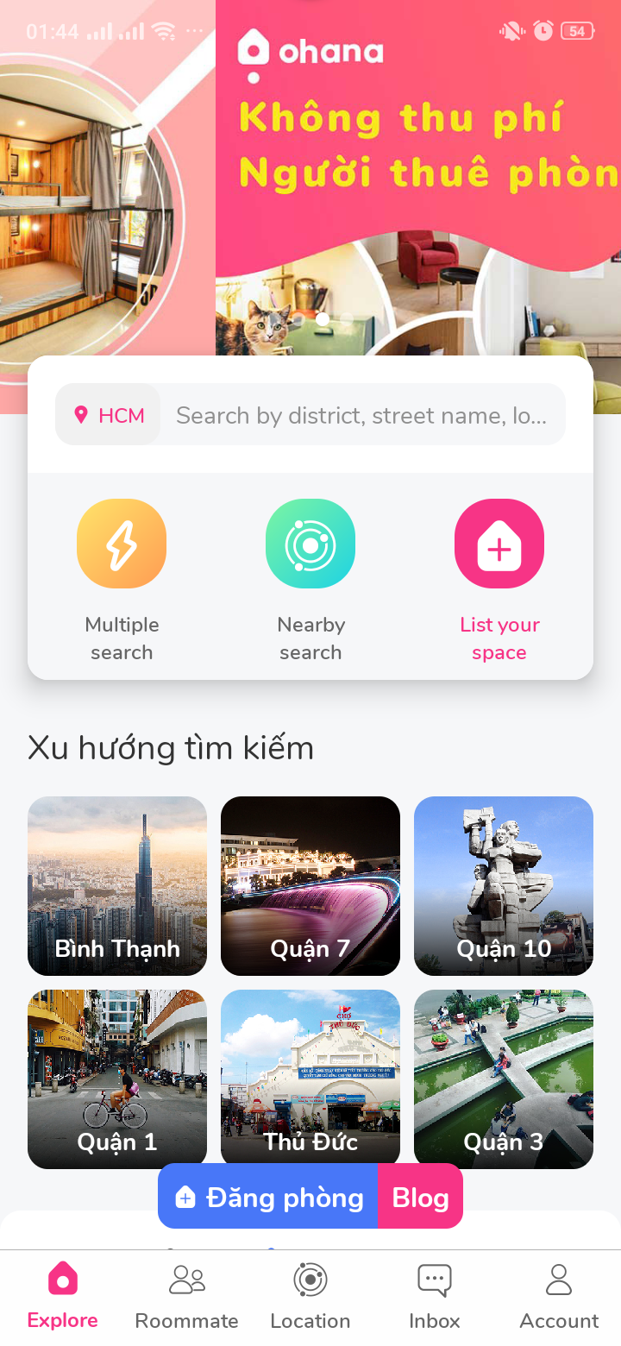

ohana
a) Mobile application GUI
This software can be downloaded on Google Play and App Store . The mobile app is used by the customers of the motel bokerage. If an user is a new user, he/she can register an account through the app and login. From the app:
• User can check the following parameters: Price,Utilities, type of rooms,gender, ...
• Users also receive comment and notifications when owner need to find customer
• Update location user through the app.

Slide 12
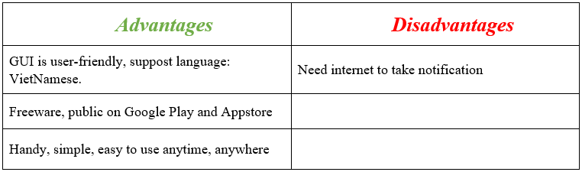

Slide 13
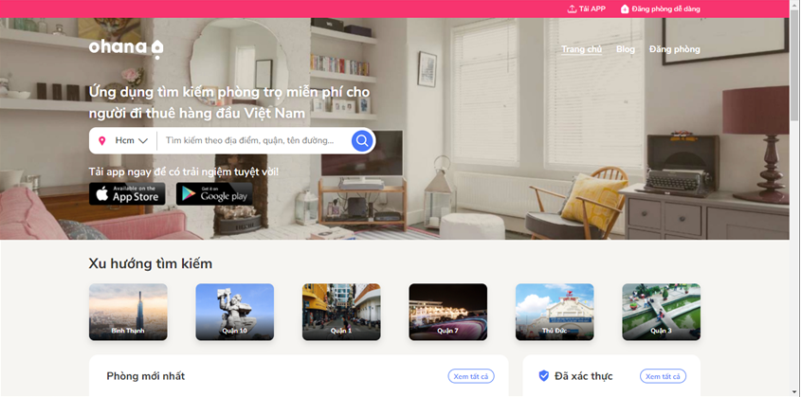
ohana
b) Web application
This software is published publicly on the Internet and it is freeware. It covers bussiness aspects that a motel bokerage would face in a real life situation, such as creating, reading, updating and deleting motel and order cylinder informations, etc... This software supports only remote access and all data stored on a server. The server uses Database-as-a-Service (DaaS), which brings many benefits such as Security, High Availability, less configuration. That’s a good option and example for us to consider using DaaS.

Slide 14
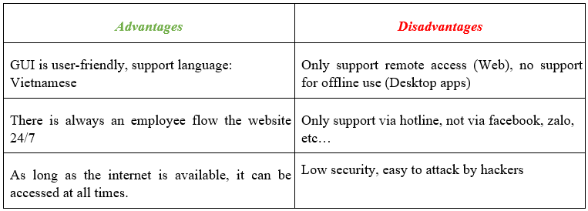

Slide 15
Business opportunity

Slide 16
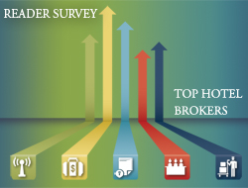
These days , finding places to stay for students is common need in every university , even the university its self can’t adapt or receive the big number of students for stayed at dorm or even satisfy students need. Therefore students mostly need a service that help them reducing the time on finding a new places to live and learn near their university . There’s a lot of system , app can adapt students need for Examples like : “Ohana”, “Hello Rent” ect…. To find a new places to live , but mostly current app offer a deal just for adults who have jobs and does not suitable for Students . So we have the solution for all students , now just only supply at Hoa Lac ( FPT university ) but in the future , is widely known in all the university , we call it “Motel Brokerage System” . This system provide all of the things that others apps has , but most important , this system connect the administrator of the house to the student that rent with affordable price, near the FPT university.

Slide 17
Software product vision

Slide 18
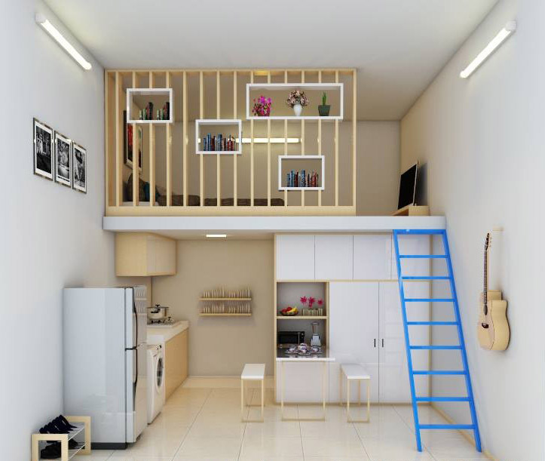
Necessary features to help users easily access and rent a room as soon as possible:
- Searching and view motel detail: give students many options to search like search by sector, by price, by area of room, by max volumn of room, by type of renting
- Rating & Comment: students can rate their current rented-motel. Motel owners can base on supporting comments to fix/develop motel services
- Sychronyze: rooms that are in negotiation will be marked to avoid conflict between students
- Students management: motel owner will have information of students who renting their rooms
Future feature:
- Payment method: student can deposit online with motel owners through bank account, ATM/internet banking
- Finding pair: students upload their bio if they want to finding pair, other students can be searched by key word

Slide 19
Project Scope & Limitations

Slide 20
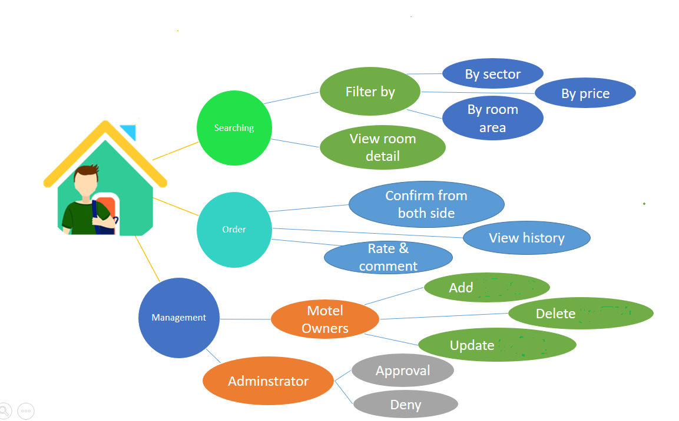
Motel Brokerage System is system give user easily access and rent a room as soon as possible
Motel owners easier to reaching user and have more income

Slide 21
Major Feature
❖ Web page :
➢ Role: User
▪ Search for motel by property
▪ Create & confirm order
▪ Rate & comment room/motel
➢ Role: motel owners
▪ Manage renting students
▪ Allows users to add ,view , modify and delete motel
➢ Role: Admin
▪ Allow Admin to Approve/Deny motel owners

Slide 22
limitation
• Not yet developed mobile app
• Low security

Slide 23
Thanks for listening

